Slide 1
2024 GDE & AskO3
全球开发者大赛
Fuel control portable
GIT EL SALVADOR

Slide 2
作品信息 Submission Information
作品名称Presentation Name ：
Fuel control portable
团队名称 Team Name： Mexico GNOC Tools team 1
团队成员 Team Member：Juan Abel Padilla Soria 00872446, Jorge Ivan Medina Garcia
区域 Region： Latin America
领域 Domain ：AMS
赛道/Track：GDE Track
申报奖项/Award：GDE Excellent Works Award
作品应用范围 Application Scope ：Management
作品应用主要项目Main Projects of Work Application ：Fuel control portable

Slide 3
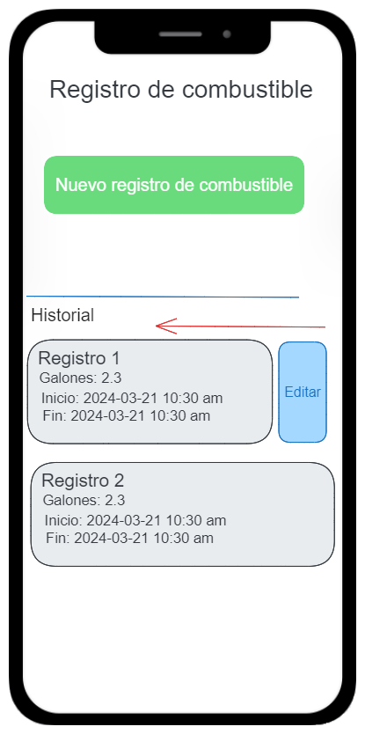
Main fuel page
需求分析&背景介绍 Requirement analysis
Refuel activity list
Add new refuel activity

Slide 4
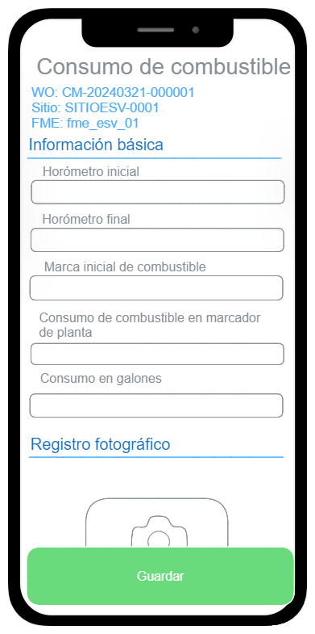
Fuel form
需求分析&背景介绍 Requirement analysis
FME must fill checklist of fuel consumption

Slide 5
业务挑战及痛点 Business Challenges and Pain Points
PC page configuration

Slide 6
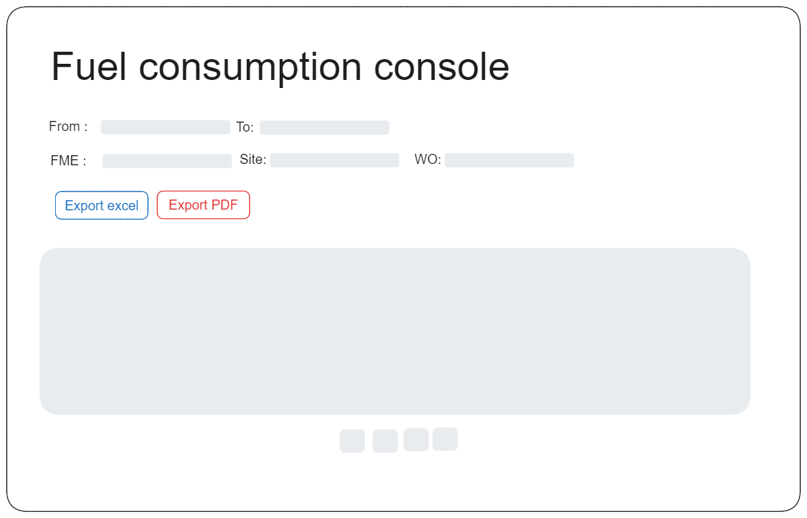
业务挑战及痛点 Business Challenges and Pain Points
Report console
After work order completion web users can
Generate PDF web report
Export Excel info

Slide 7
解决方案及作品介绍 Solution and product introduction
Second phase PDF report build
WEB REPORT

Slide 8
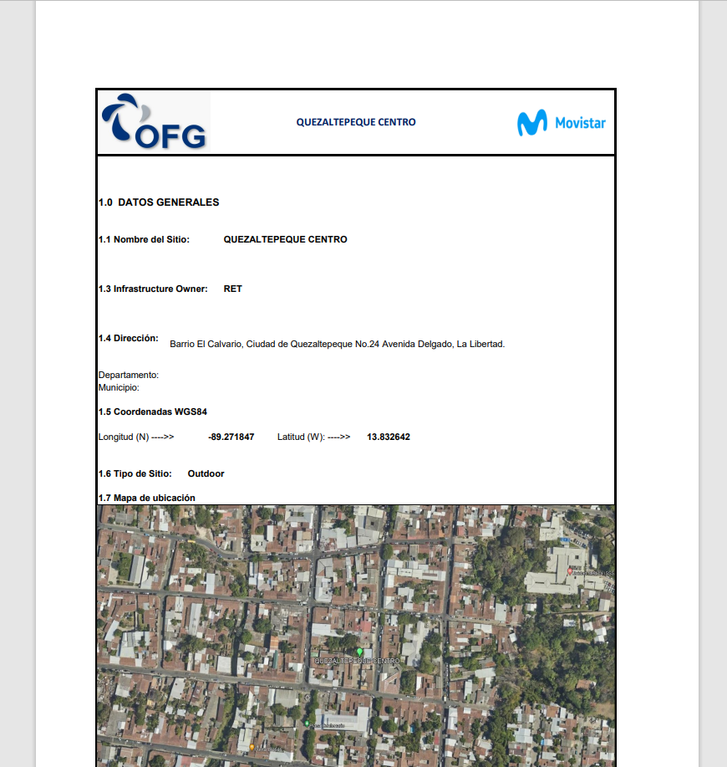
作品方案架构介绍 Introduction to the Scheme Architecture
PDF web (second phase)
The web report can be displayed on web and be printed

Slide 9
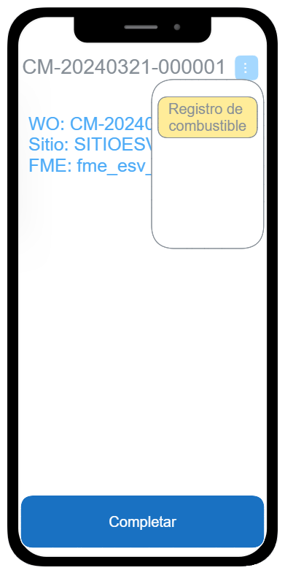
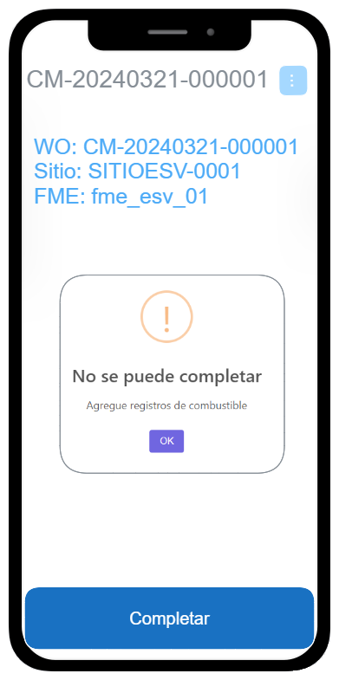
作品方案架构介绍 Introduction to the Scheme Architecture
WFM integration
A button to go to refuel activity will available before complete the work fuel
If try to complete without fuel consumption register the system throws an error

Slide 10
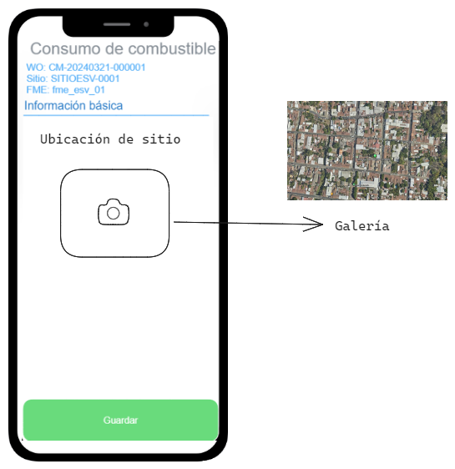
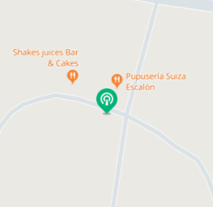
作品方案架构介绍 Introduction to the Scheme Architecture
MAP capture (second phase)
Proposal 1 → Left FME upload from gallery Proposal 2 → Auto-generate in GDE
1. Take screenshot
2. ⚠️ If the Huawei MAP is not available the image can’t be generated

Slide 11
方案价值与收益 Solution Value and Revenue
Work plan

Slide 12
THANK YOU！

